Slide 1
Introduction to Markup Language
Unit 1

Slide 2
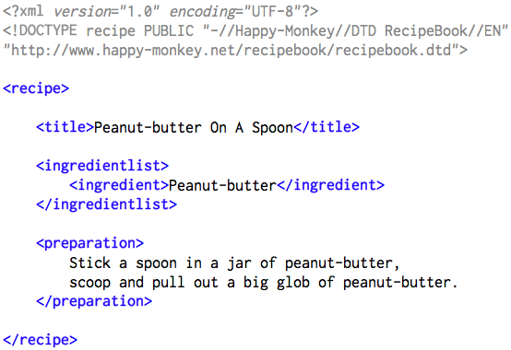
What is a markup language?
A markup language is a modern system for annotating a document in a way that is syntactically distinguishable from the text.
The idea and terminology evolved from the "marking up" of manuscripts, i.e., the revision instructions by editors, traditionally written with a blue pencil on authors' manuscripts.

Slide 3
Features
A common feature of many markup languages is that they intermix the text of a document with markup instructions in the same data stream or file.
<html>
<!-- Our first Web page -->
<head>
<title> Markup Languages – Welcome </title>
</head>
<body>
<p> Welcome to Our Web Site! </p>
</body>
</html>

Slide 4
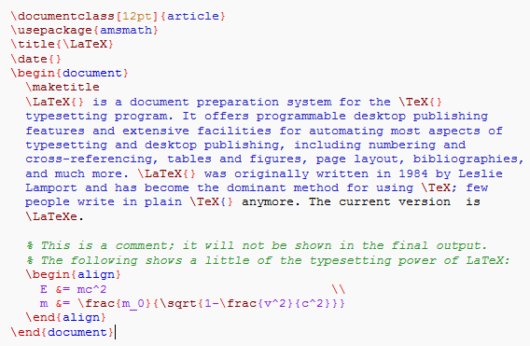
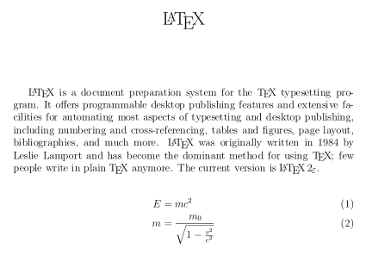
Types
Presentational markup
The kind of markup used by traditional word-processing systems: binary codes embedded in document text that produce the WYSIWYG effect.
Procedural markup
Markup is embedded in text and provides instructions for programs that are to process the text. Well-known examples include troff, LaTeX, and PostScript.
Descriptive markup
Markup is used to label parts of the document rather than to provide specific instructions as to how they should be processed.

Slide 5
Well-know markup languages
HyperText Markup Language (HTML) – the original markup language that was defined as a part of implementing World Wide Web.
Extensible HyperText Markup Language (XHTML): HTML reformulated in XML syntax.
XHTML Basic – a subset of XHTML for simple (typically mobile, handheld) devices. It is meant to replace WML, and C-HTML.
XHTML Mobile Profile (XHTML MP) – a standard designed for mobile phones and other resource-constrained devices.
Mathematical Markup Language (MathML)
Scalable Vector Graphics (SVG)
TeX, LaTeX – a format for describing complex type and page layout often used for mathematics, technical, and academic publications.
Extensible 3D (X3D)

Slide 6
HTML, XHTML and CSS
Cascading Style Sheets (CSS) is a style sheet language used for describing the presentation semantics (the look and formatting) of a document written in a markup language. Its most common application is to style web pages written in HTML and XHTML, but the language can also be applied to any kind of XML document.
body { background-color:#d0e4fe; } h1 { color:orange; text-align:center; } p { font-family:"Times New Roman"; font-size:20px; }

Slide 7
What is XML?
XML stands for EXtensible Markup Language.
XML is a markup language much like HTML
XML was designed to carry data, not to display data.
XML tags are not predefined. You must define your own tags.
XML is designed to be self-descriptive
XML is a W3C Recommendation.

Slide 8
XML DTD
The purpose of a DTD (Document Type Definition) is to define the legal building blocks of an XML document.
A DTD defines the document structure with a list of legal elements and attributes.
<!DOCTYPE NEWSPAPER [
<!ELEMENT NEWSPAPER (ARTICLE+)> <!ELEMENT ARTICLE (HEADLINE,BYLINE,LEAD,BODY,NOTES)> <!ELEMENT HEADLINE (#PCDATA)> <!ELEMENT BYLINE (#PCDATA)> <!ELEMENT LEAD (#PCDATA)> <!ELEMENT BODY (#PCDATA)> <!ELEMENT NOTES (#PCDATA)> <!ATTLIST ARTICLE AUTHOR CDATA #REQUIRED> <!ATTLIST ARTICLE EDITOR CDATA #IMPLIED> <!ATTLIST ARTICLE DATE CDATA #IMPLIED> <!ATTLIST ARTICLE EDITION CDATA #IMPLIED>
]>

Slide 9
XML Markup Languages
http://en.wikipedia.org/wiki/List_of_XML_markup_languages
XHTML: a markup language that has the same depth of expression as HTML, but with a syntax conforming to XML.
XML Schema: a description of a type of XML document, typically expressed in terms of constraints on the structure and content of documents of that type.
XPath: an expression language for addressing portions of an XML document

Slide 10
XML Markup Languages
http://en.wikipedia.org/wiki/List_of_XML_markup_languages
XQuery: a query language designed to query collections of XML data (similar to SQL).
XSL Transformations: a language used for the transformation of XML documents.

Slide 11
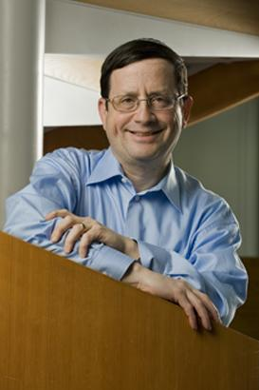

W3C
The World Wide Web Consortium (W3C) is an international community where Member organizations, a full-time staff, and the public work together to develop Web standards. Led by Web inventor Tim Berners-Lee and CEO Jeffrey Jaffe, W3C's mission is to lead the Web to its full potential.

Slide 12
Tools
XML Copy Editor is free software and released under the GNU General Public License.
Features
Validation as you type
Tag protection
XML Schema/Relax NG/DTD support
XSLT, XPath
NotePad++
Aptna

